Slide 1
Brief guide on how to select ENS-filing type
Notes:
5 minutter

Slide 2
What is an ENS declaration?
Entry Summary Declarations (ENS) must be submitted for all consignments entering the EU security area.
A complete ENS declaration consists of one or more data sets - also referred to as ENS filings or F-messages - that can be submitted by one party or in a collaboration between several parties.
It is the carrier who has the overall responsibility for submitting the ENS declaration. However, all affected companies are obliged to supplement with relevant ENS information if the information is not shared with the carrier.
For more information on the rules for lodging an entry summary declaration, see the Union Customs Code (UCC), Article 127.
2
Notes:
Se mere om reglerne for indgivelse af en summarisk indpassageangivelse i EU-toldkodeksen (EUTK), Atikel 127.
Artikel 127, stk. 4: Den summariske indpassageangivelse skal indgives af transportøren. Uden at dette berører transportørens forpligtelser, kan den summariske indpassageangivelse i stedet indgives af en af følgende personer: a) importøren eller modtageren eller en anden person, i hvis navn eller på hvis vegne transportøren handler b) enhver person, som er i stand til at frembyde de pågældende varer eller få dem frembudt på indgangstoldstedet.
Artikel 127, stk. 5: Den summariske indpassageangivelse skal indeholde de oplysninger, der er nødvendige for risikoanalysen af sikrings og sikkerhedshensyn.
Artikel 127, stk. 6: I specifikke tilfælde, hvor alle de i stk. 5 nævnte oplysninger ikke kan tilvejebringes fra de i stk. 4 nævnte personer, kan det kræves, at andre personer, der er i besiddelse af disse oplysninger, og som har de behørige rettigheder til at fremlægge dem, giver disse oplysninger

Slide 3
Composition of ENS declarations
ENS filing types for Sea
Complete dataset
Partial
dataset
F10 | Non-negotiable bill of lading containing the necessary information from the consignee. | X
F11 | Master bill of lading with the underlying freight forwarding bill(s) containing the necessary information from the consignee of the lowest freight forwarding bill. | X
F12 | Master bill of lading only. |  | X
F13 | Non-negotiable bill of lading only. |  | X
F14 | Freight forwarding bill of lading only. |  | X
F15 | Freight forwarding bill of lading with the necessary information provided by the consignee. |  | X
F16 F17 | Necessary information must be provided by the consignee at the lowest level of the transport contract (lowest freight forwarding bill of lading when the master bill of lading is or is not a non-negotiable bill of lading). |  | X
F45 | Postal shipments – master bill of lading only |  | X
With ICS2, several parties can provide information to the same ENS. This is called multiple filing.
ICS2 allows each party to provide the part of the information they possess. Therefore, a company does not need to share all information with the carrier or freight forwarder.
A complete ENS can be composed in many ways, depending on the mode of transport and the type of transport contract.
Information for ENS declarations is submitted as ENS filings. ENS filings are data sets.
3

Slide 4
High level information – master and house
Two levels of information
Master consignment
House consignment
General information from the main bill of lading on the active transport of goods across the EU border.
For sea transport, this means the captain’s declaration of which consignments are on board and the delivery agreement the carrier has entered for these.
Information regarding the shipping agreement concluded by a shipper with a freight forwarder.
For a freight forwarder, this applies to consignments that are handed over to a carrier on behalf of one or more consignors or consignees (the freight forwarder's customers).
For a postal operator, this will generally be information about a specific parcel.
4

Slide 5
4 levels of ENS information – high level
Declaration main heading Information about the declarant and the transport.
Master information
Contract information from MWB/MBL*, e.g. general information about the goods and who the carrier is to deliver the goods to.
House information
Information about the individual product, including the actual consignor and consignee.
Shipment information
Information about the buyer and seller of the item.
Only relevant for sea, road and rail.
5
*Master (Air) Way Bill/ Master Bill of Lading

Slide 6
Categories of ENS declarations
Direct
There are different categories of declarations. Which one to use depends, among other things, on whether a freight forwarder is involved or not.
Direct
Complete ENS declaration without the involvement of a freight forwarder
Full
Complete ENS declaration with involvement of a freight forwarder
Master
Partial ENS declaration with information about the carrier and general information about the goods
House
Partial ENS declaration with information provided by the freight forwarder
PLACI (Pre-loading Advanced Cargo Information) (house): minimum ENS declaration prior to loading (air transport only)
Goods Shipment (house): ENS declaration with information about who is trading (buyer and seller) (not air transport)
Exporter
Not directly
MWB
HWB
Importer

Slide 7
Combinations of ENS filing types
Different combinations of ENS filing types are used depending on whether it is multiple filing, direct shipments or complete declarations

Slide 8
Combinations of ENS filing types – Air
Scenarios | Pre-load |  | Pre-arrival |  | Explanation
 | House | Master air waybill | Master | House
Scenario 1 A/B | F24 |  | F21 | F22 | F24 or F23 and F25 are submitted prior to loading the aircraft. This contains the Pre-Load Advanced Cargo Information (PLACI), which is the minimum dataset that must be submitted prior to loading. F23 is used if PLACI is submitted before you have MAWB. When you have MAWB, F25 is submitted. If you have MAWB when you submit PLACI, an F24 is used. F21 and F22 are submitted pre-arrival and contain the remaining information.
 | F23 | F25
Scenario 2 | F26 |  | F21 | From Pre-load house | F26 is submitted before loading the aircraft. F26 contains all required house and PLACI information. F21 is submitted pre-arrival and contains all required master information.
Scenario 3 | F20 |  |  |  | F20 is used when all required information is available prior to loading and the information is submitted by one party (typically the airline).
Scenario 4 A/B | F24 |  | F27 |  | F24 is submitted before loading the aircraft. It contains Pre-Load Advanced Cargo Information (PLACI), which is the minimum dataset that must be submitted before loading. F23 is used if PLACI is submitted before you have MAWB and must be supplemented by F25 when MAWB is known. F27 is submitted pre-arrival and contains all remaining information.
 | F23 | F25
Scenario 5 | F28 |  |  | As Master | F28 is used when all required information is available before loading and it is a direct shipment, i.e. without the involvement of the freight forwarder. The information is typically submitted by the airline.
Scenario 6 A/B | F24 |  | F29 | As Master | F24 is submitted before loading the aircraft. It contains Pre-Load Advanced Cargo Information (PLACI), which is the minimum dataset that must be submitted before loading. F23 is used if PLACI is submitted before you have MAWB and must be supplemented by F25 when MAWB is known. F29 is submitted pre-arrival when it is a direct shipment, i.e. without the involvement of the freight forwarder. F29 contains all remaining information.
 | F23 | F25
Postal shipments | F43 + F44 |  | F42 | From Pre-load house | F43 is submitted by the postal operator pre-load and is used for the pre-load risk analysis. F44 is also submitted by the postal operator when the receptacle is completed. F44 contains information of which F43 is in which receptacle. F42 is submitted by the airline pre-arrival.
*Grey text indicates use of previously submitted information

Slide 9
Combinations of ENS filing types – Sea
Scenarios | Level |  |  | Explanation
 | Master | House | Shipment of goods
Direct shipment to predetermined recipient without the involvement of the freight forwarder (non-negotiable bill of lading). | F10 (Duplicate from Master) |  | F10 (from Master) | F10 is used when the transport contract is a non-negotiable bill of lading (i.e. without the involvement of the freight forwarder) and the carrier has all the necessary information.
Master bill of lading and underlying freight forwarder bills of lading. Freight forwarder is involved in the transport. | F11 |  |  | F11 is used when a freight forwarder is involved in the shipment and the carrier has all the necessary information.
Separate declaration of master, house and goods shipment information | F12 | F14 | F16 | F12, F14 and F16 are used in a combination where the carrier submits master information (F12), the freight forwarder submits house information (F14) and the buyer/seller submits goods shipment information (F16).
Separate declaration of master and house incl. goods shipment information | F12 | F15 |  | F12 and F15 are used in a combination where the carrier submits master information (F12), the freight forwarder submits house information (F15) in which the goods shipment information is included.
Direct shipment to predetermined consignee (F13) and separate goods shipment information (F17) | F13 (Duplicate from Master) |  | F17 | F13 and F17 are used when the transport contract is a non-negotiable bill of lading (i.e. without the involvement of the freight forwarder) and where the carrier does not have information about the buyer and seller.
Postal shipments | F45 | F43 + F44 | N/A | F45, F43 and F44 are used for postal shipments. The postal operator submits F43 and F44 and the carrier submits F45.

Slide 10
Combinations of ENS filing types – Road
Scenarios for road | Level |  |  | Explanation
 | Master | House | Shipment of goods
Full dataset for road transport | F50 |  |  | F50 is used for regular road transport. F50 is a full dataset with all the necessary information. F50 is typically submitted by the carrier. F50 contains both carrier, freight forwarder and goods shipment information.
Separate declaration of master and house data | F56 | F57 |  | F56 is submitted by the carrier and contains master information. F57 is typically submitted by the freight forwarder and contains house and consignment information
Separate declaration of master, house and consignment data | F56 | F58 | F59 | F56, F58 and F59 are used in a combination where the carrier submits master information (F56), the freight forwarder submits house information (F58), and the buyer/seller submits consignment information (F59).
Express shipments by road | F34 |  |  | F34 is used for express shipments by road. F34 contains all the necessary information.
Postal shipments by road | F40 | F43 + F44 | N/A | F43 is submitted by the postal operator pre-load and is used for the pre-load risk analysis. F44 is also submitted by the postal operator when the receptacle is completed. F44 contains information of which F43 is in which receptacle. F40 is submitted by the carrier pre-arrival.
Note:
F56, F57, F58 and F59 are planned to be in use from June 2026. Until then, only the F50, F34 and F40 can be used for road transport.

Slide 11
Combinations of ENS filing types – Rail
Scenarios for rail | Level |  |  | Explanation
 | Master | House | Shipment of goods
Complete dataset for rail | F51 |  |  | F51 is used for regular rail transport when the carrier has all the necessary information.
Separate declaration of master and house data | F52 | F53 |  | F52 is submitted by the carrier and contains master information. The F53 is typically submitted by the freight forwarder and contains house and goods shipment information.
Separate declaration of master, house and goods shipment data | F52 | F54 | F55 | F52, F54 and F55 are used in a combination where the carrier submits master information (F52), the freight forwarder submits house information (F54) and the buyer/seller submits goods shipment information (F55).
Postal shipment by rail | F41 | F43 + F44 | N/A | F43 is submitted by the postal operator pre-load and is used for the pre-load risk analysis. F44 is also submitted by the postal operator when the receptacle is completed. F44 contains information of which F43 is in which receptacle. F41 is submitted by the carrier pre-arrival.
Note:
F52, F53, F54 and F55 are planned to be in use from December 2025. Until then, only the F51 and F41 can be used for rail transport.

Slide 12
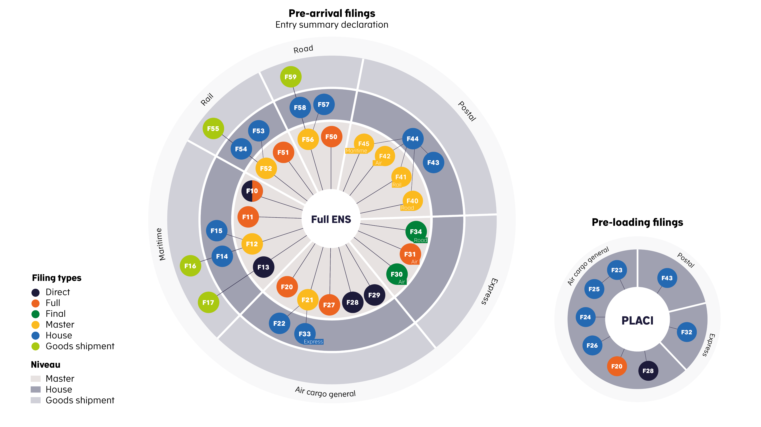
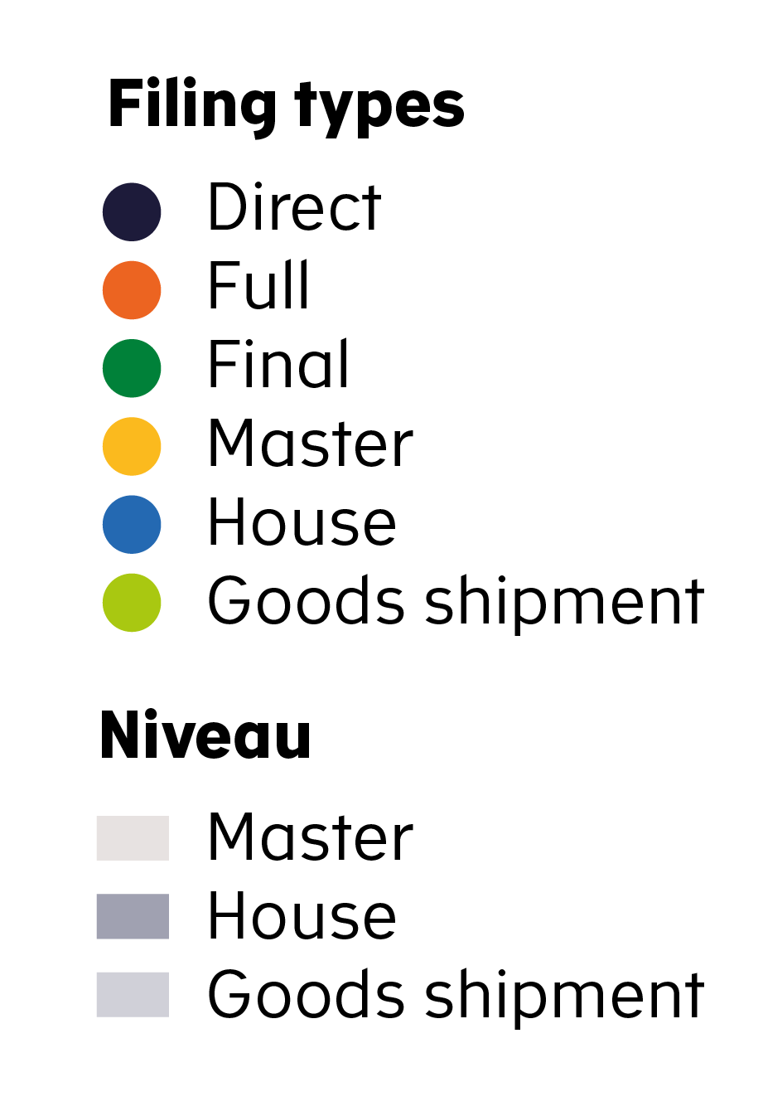
Combinations of ENS filing types
Link to combinations of ENS filing types for air (only available in Danish)
Link to combinations of ENS filing types for sea, road and rail (only available in Danish)
PLACI = Pre-load Advanced Cargo Information

Slide 13
How to select ENS filing types

Slide 14
How do I select ENS filing types for air cargo?
What is your role - are you a carrier, freight forwarder, express courier or postal operator? Or more of these?
Which information do you have?
When is the information available to you?
Do you have MAWB when submitting PLACI?
What kind of transport contracts do you enter (direct, not direct)?
Which information will you share or not share with your collaborators?
14

Slide 15
Example: Transport by air
Direct shipping?
Postal shipments
YES
NO
F43
Do I have all the information when PLACI must be submitted?
Do I have all the information when PLACI must be submitted?
+
YES
NO
YES
NO
F44
F28
Do I have MAWB when submitting PLACI?
F20
Do I have all the House and PLACI information when PLACI must be submitted?
+
Scenario 5
YES
NO
Scenario 3
YES
NO
F42
F24
F23
F26
Do I have MAWB when PLACI must be submitted?
+
+
+
YES
NO
F29
F25
F21
Submitted when MAWB is known
F24
F23
Scenario 6A
+
Scenario 2
+
F29
F25
Submitted when
MAWB is known
Who Submits
Scenario 6B
Do I have all the information when a complete ENS must be submitted?
Carrier
Freight forwarder
YES
NO
Do I have all the information when a complete ENS must be submitted?
Carrier submits pre-load
F27
F21
Freight forwarder submits pre-load
Scenario 4A
+
YES
NO
Postal operator
F22
F27
F21
Scenario 1A
+
Scenario 4B
F22
The Scenario numbers refer to the scenarios described on slide 8, ”Combinations of ENS filing types – Air ”.
Scenario 1B

Slide 16
How do I select ENS filing types for sea transport?
Direct shipping?
YES
NO
Does the carrier have all information required?
Does the carrier have all information required?
YES
NO
YES
NO
Are you a carrier, freight forwarder, buyer/seller or do you represent several parties?
Which mode of transport do you use?
What kind of transport contracts do you enter (direct, not direct)?
What information do you have?
What information will you share or not share with your collaborators?
When is the information available to you?
F10
F13
F11
F12
+
F17
Does the freight forwarder have all the required goods shipment information?
YES
NO
F15
F14
+
F16
Postal shipments
F43
+
Who submits?
F44
Carrier
Freight forwarder
+
Buyer/seller
F45
Postal operator
16

Slide 17
How do I select ENS filing types for road transport?
Is it an express consignment by road?
YES
NO
F34
Does the carrier have all information required?
Is it an express consignment or a regular consignment?
Are you a carrier, freight forwarder, buyer/seller or do you represent several parties?
Which mode of transport do you use?
Which information do you have?
Which information will you share or not share with your collaborators?
YES
NO
F50
F56
Postal shipments
F43
Does the freight forwarder have all goods shipment information required ?
+
F44
YES
NO
+
F57
F58
F40
+
F59
Note:
F56, F57, F58 and F59 are planned to be in use from June 2026. Until then, only the F50, F34 and F40 can be used for road transport.
Who submits?
Carrier
Freight forwarder
Buyer/seller
Postal operator
17

Slide 18
How do I select ENS filing types for rail transport?
Does the carrier have all information required?
YES
NO
F51
F52
Are you a carrier, freight forwarder, buyer/seller or do you represent several parties?
Which mode of transport do you use?
Which information do you have?
Which information will you share or not share with your collaborators?
Does the freight forwarder have all goods shipment information required ?
Postal shipments
F43
YES
NO
+
F53
F54
F44
+
+
F55
F41
Note:
F52, F53, F54 and F55 are planned to be in from December 2025. Until then, only the F51 and F41 can be used for rail transport.
Who submits?
Carrier
Freight forwarder
Buyer/seller
Postal operator
18

Slide 19
Linking information
Linking of ENS filings is handled by the European system Common Repository. The process is regulated by different timer rules.
It is expected that the master declaration will generally be submitted after the house. Therefore, it is not possible for the house declaration to reference the MRN number of the master.
Instead, “functional references" are used. This means that the relationship between master and house is created from general information in the partial declarations.
In general, a combination of the carrier identification number (EORI) and master transport document reference number (MAWB, MBL) is used.
F12 / F13
Short sea
Linking expiration timer related to time of arrival
F12 / F13
Deep sea
Linking expiration timer related to time of departure

Slide 20
When must an ENS-declaration be submitted to the EU?
Air
PLACI – As early as possible before loading
4 hours prior to arrival in the EU (long-haul flights:
4-hours or longer)
At departure of the flight (short-haul flights: less than 4 hours)
Sea
24 hours prior to loading (deep sea containerised cargo)
4 hours prior to arrival in the EU (bulk)
2 hours prior to arrival in the EU (goods originating from e.g. Greenland, Iceland, United Kingdom, and ports in the North and Baltic Seas)
Road
2 hours prior to arrival in the EU (for truck on a ferry)
1 hour prior to arrival in the EU
Rail
2 hours prior to
arrival in the EU (transportation time:
2 hours or longer)
1 hour prior to arrival in the EU (transportation time: less than 2 hours)

Slide 21
Abbreviations
ENS - Entry Summary Declaration
MAWB - Master Air Way Bill
MWB - Master Way Bill
MBL - Master Bill of Lading
N/A - Not Applicable
PLACI - Pre-loading Advanced Cargo Information
21

Slide 22
Usefull links
Sign up for the Danish Customs Agency’s newsletter about the new systems (available in Danish only): Sign up for Danish Customs Agency's newsletter
Link to the Danish Customs Agency’s ICS2-page (available in Danish only): ICS2 Toldstyrelsen
Manifest guides (available in Danish only):
https://toldst.dk/erhverv/toldsystemer/manifest
Danish Customs Agency service status information
Service status information and customs’ system status
CIRCABC – EU-Commission’s public library
EU Advance Cargo Information System (ICS2)
Here you will also find a calendar with public EU ICS2 meetings and important information from the EU regarding ICS2
EU’s general ICS2 site
Import Control System 2 (ICS2) (europa.eu)
EU's ICS2-FAQ and documentation
FAQ (europa.eu)
BCP in EU’s public library:
ICS2 Business Continuity
Danish Customs Agency’s ICS2 Servicedesk Mail: ics2support@toldst.dk Phone: +45 7222 1215 Opening hours: Monday-Sunday 00:00-24:00 – between 08.00 PM-07.00 AM only for critical ICS2 related incidents.
22

